Slide 1
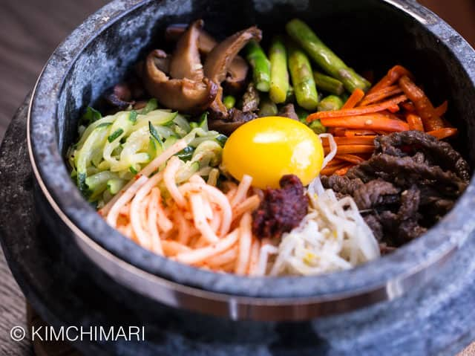
Home
About us
Menu
Gallery
Contact
Ｋorean Food
Various Korean Style food available here !!
Best Cuisine for the most
exquisite taste!!

Slide 2
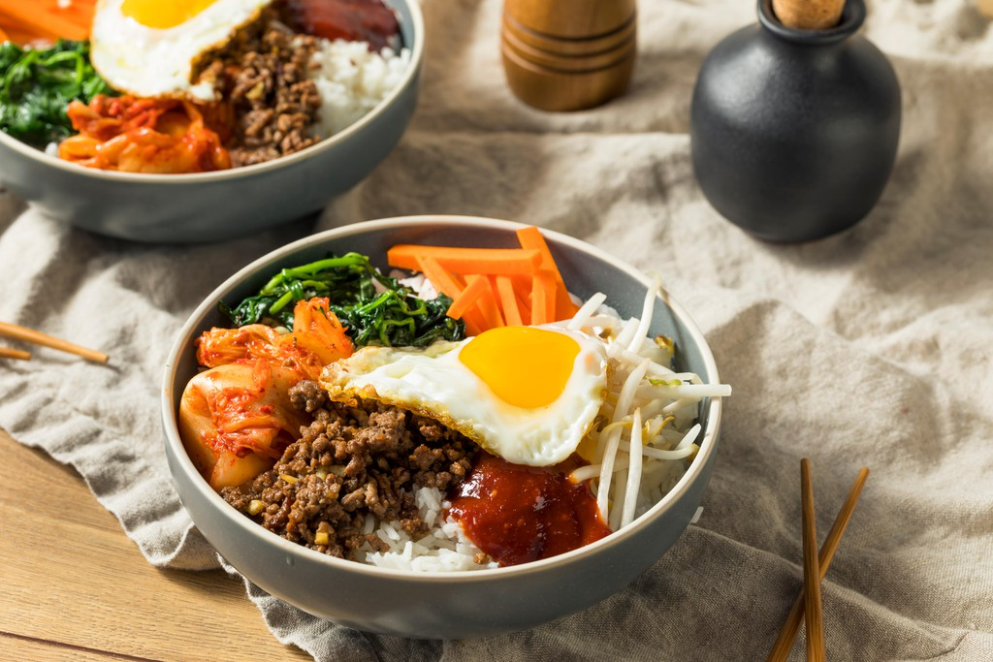
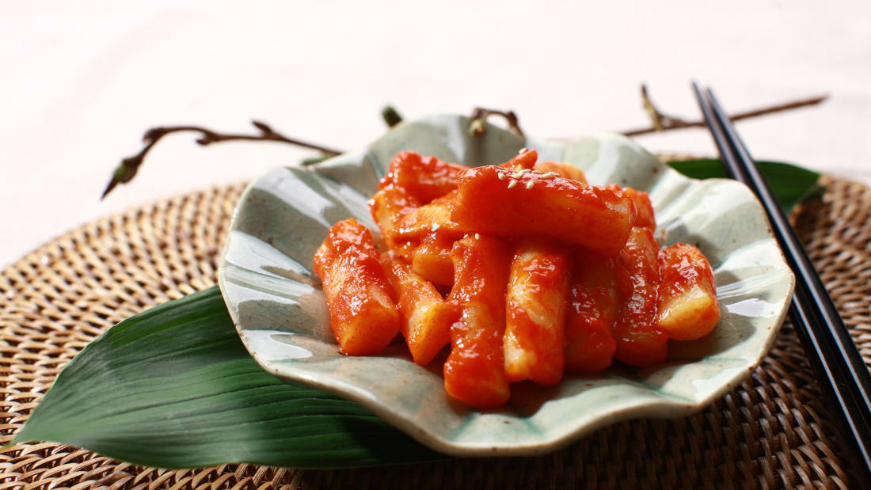
Home
About Us
Menu
Gallery
Contact
1.Bibimbap (mixed rice)
Bibimbap is essentially a bowl of mixed ingredients including, but not limited to, rice namul (seasoned and sautéed vegetables), mushrooms, beef, soy sauce, gochujang (chili pepper paste), and a fried egg.
2.Tteokbokki: This iconic red-orange street food is so popular there's an entire town in Seoul just devoted to
the steamed and sliced rice cakes (tteok), cooked with fish cakes (oden) and scallions in a sweet and spicy
sauce made of chili paste.

Slide 3
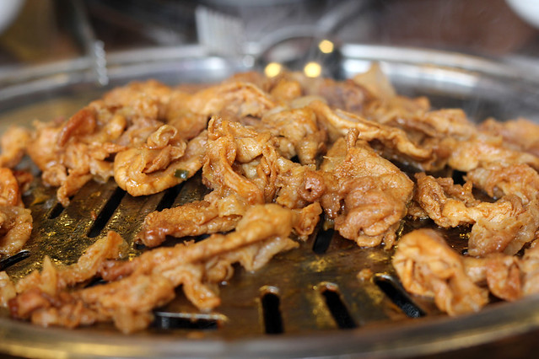
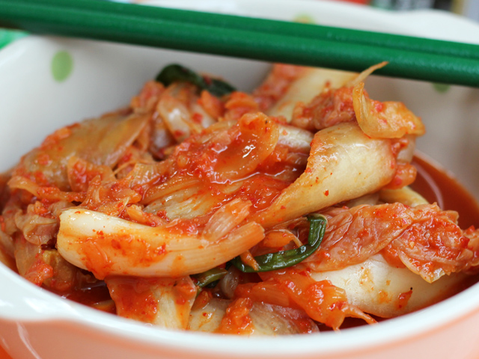
Home
About us
Menu
Gallery
Contact
Home
3. Pork Bulgogi (Daeji Bulgogi )
Another famous Korean specialty barbecued meat is known as Bulgogi.
While it’s normally made from beef bulgogi can also be made with thin
strips of pork or chicken.
Before the meat is grilled, it’s marinated in sweet soy sauce with
lots of garlic and sesame oil.
4. Chili Pickled Cabbage (Kimchi )
I’m going to start this South Korean food list with not really a dish at all, but something that is critically vital and quintessential to any Korean meal: KIMCHI.

Slide 4
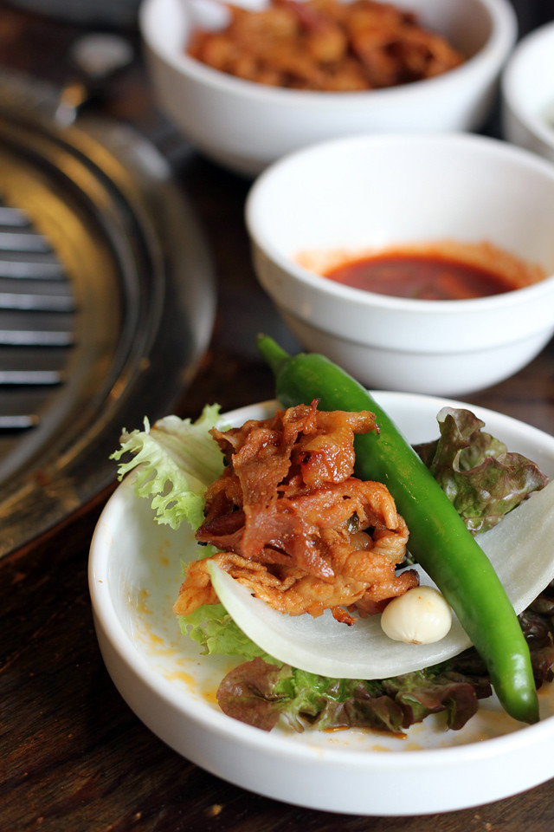
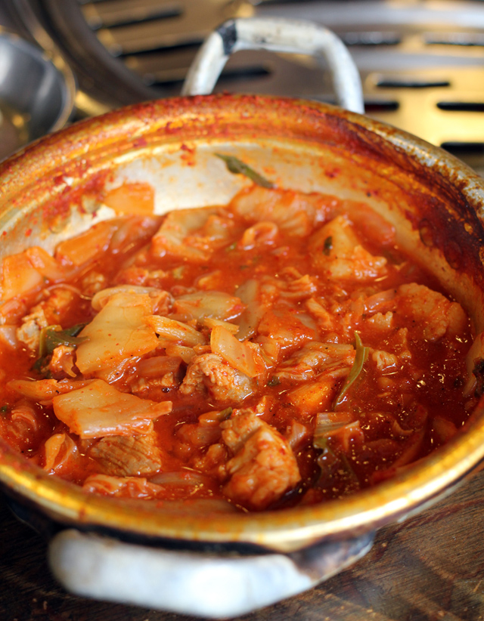
Home
About us
Menu
Gallery
Contact
6. Kimchi Stew
South Korean food is unbelievably delicious, but if I could choose just one thing to eat over and over again, it would have to be kimchi..
5. Korean Barbecue
There’s no better way to spend an evening in Korea than sitting around a personal grill munching down a traditional Korean barbecue feast.

